Slide 1
Collisions & Contact

Slide 2
Collision Detection & Response
Particle-plane collision detection
Polyhedron-polyhedron collision detection
overlap of Bounding volumes
Vertex inside polyhedron test
Concave case
Convex case
Edge-face intersection test
detection
kinematic response
Penalty method
Impulse force of collision
response

Slide 3
Collision Detection: Point - Plane
N

Slide 4
Collision Detection: Time of Impact
2 options
Consider collision at next time step
Compute fractional time at which collision actually occurred
Tradeoff: accuracy v. complexity

Slide 5




Collision Response: Kinematic
$$v\left(t_{i+1}\right)=v\left(t_{i}\right)−N∙N^{T}∙v\left(t_{i}\right)−k(N∙N^{T}∙v\left(t_{i}\right))$$
$$v\left(t_{i}\right)−N∙N^{T}∙v(t_{i})$$
$$=v\left(t_{i}\right)−(1+k)(N∙N^{T}∙v\left(t_{i}\right))$$
N
$$v\left(t_{i}\right)$$
$$N∙N^{T}∙v(t_{i})$$
k: coefficient of restitution (a damping factor)
=1 indicates no energy loss
Negate component of velocity in direction of normal
No forces involved!

Slide 6
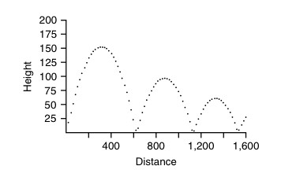
Collision Response: Damped
Damping factor k = 0.8

Slide 7
Collision Response -- Penalty Method

Slide 8
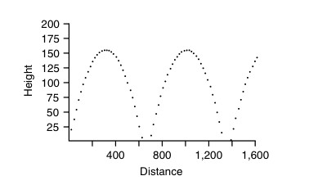
Collision Response: Penalty

Slide 9
Collision Detection: Polyhedra
Order tests according to computational complexity and power of detection
1. test bounding volumes for overlap
2. test for vertex of one object inside of other object
3. test for edge of one object intersecting face of other object

Slide 10
Collision Detection: Bounding Volumes
Don’t do vertex/edge intersection testing if there’s no chance of an intersection between the polyhedra
Want a simple test to remove easy cases
Tradeoff complexity of test with power to reject non-intersecting polyhedra
(goodness of fit of bounding volume)

Slide 11
Bounding Spheres
Compute bounding sphere of vertices
Find min/max pair of points in each dimension
use maximally separated pair – use to create initial bounding sphere (midpoint is center)
for each vertex adjust sphere to include point

Slide 12
Bounding Boxes
Axis-aligned (AABB): use min/max in each dimension
Oriented (OBB): e.g., use AABB in object space and transform with object. Vertex is inside of OBB iff inside of 6 planar equations

Slide 13
Bounding Slabs
For better fit bounding polyhedron: use arbitrary (user-specified) collection of bounding plane-pairs
Is a vertex between each pair?

Slide 14
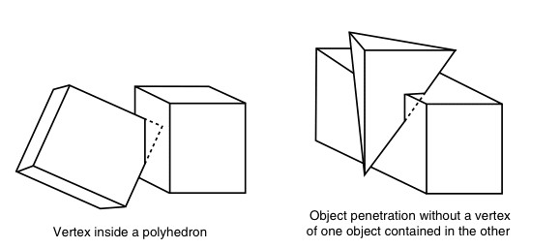
Collision Detection: Polyhedra
1. test bounding volumes for overlap
2. test for vertex of one object inside of other object
3. test for edge of one object intersecting face of other object

Slide 15
Collision Detection: Polyhedra
Intersection = NO
For each vertex, V, of object A
if (V is inside of B) intersection = YES
For each vertex, V, of object B
if (V is inside of A) intersection = YES
A vertex is inside a convex polyhedron if it’s on the ‘inside’ side of all faces
A vertex is inside a cancave polyhedron if a semi-infinite ray from the vertex intersects an odd number of faces

Slide 16
Collision Detection: Polyhedra
Edge intersection face test
Finds ALL polyhedral intersections
But is most expensive test
If vertices of edges are on opposite side of plane of face
Calculate intersection of edge with plane
Test vertex for inside face (2D test in plane of face)

Slide 17
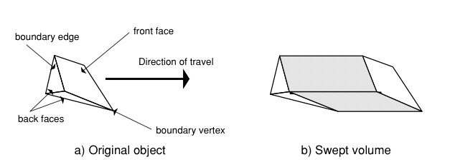
Collision Detection: Swept Volume
Time & relative direction of travel sweeps out a volume
Only tractable in simple cases (e.g. translation)
If part of an object is in the volume, it was intersected by object

Slide 18
Collision Response: Kinematic
$$v\left(t_{i+1}\right)=v\left(t_{i}\right)−N∙N^{T}∙v\left(t_{i}\right)−k(N∙N^{T}∙v\left(t_{i}\right))$$
$$v\left(t_{i}\right)−N∙N^{T}∙v(t_{i})$$
$$=v\left(t_{i}\right)−(1+k)(N∙N^{T}∙v\left(t_{i}\right))$$
N
$$v\left(t_{i}\right)$$
$$N∙N^{T}∙v(t_{i})$$
k: coefficient of restitution (a damping factor)
=1 indicates no energy loss
But now want to add angular velocity contribution to separation velocity

Slide 19
Rigid Body Simulation
Object Properties
Mass
Position
linear & angular velocity
linear & angular momentum
Calculate forces
Wind
Gravity
Viscosity
Collisions
Calculate change in attributes
Position
linear & angular velocity
linear & angular momentum
Calculate accelerations
Linear & angular using mass and inertia tensor

Slide 20
Impulse Response
How to compute the collision response of two rotating rigid objects?

Slide 21
Impulse Response
Given
Separation velocity is to be negative of colliding velocity
Compute
Impulse force that produces sum of linear and angular velocities that produce desired separation velocity

Slide 22
Rigid Body Simulation
Impulse force
Separation velocity

Slide 23
Impulse Response
Update linear and angular velocities as a result of impulse force

Slide 24
Velocities of Points of Contact

Slide 25
Rigid Body Simulation
j applied to object A; -j applied to B

Slide 26
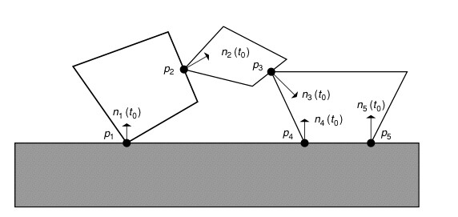
Resting Contact
Complex situations: need to solve for forces that prevent penetration, push objects apart, if the objects are separating, then the contact force is zero

